Slide 1
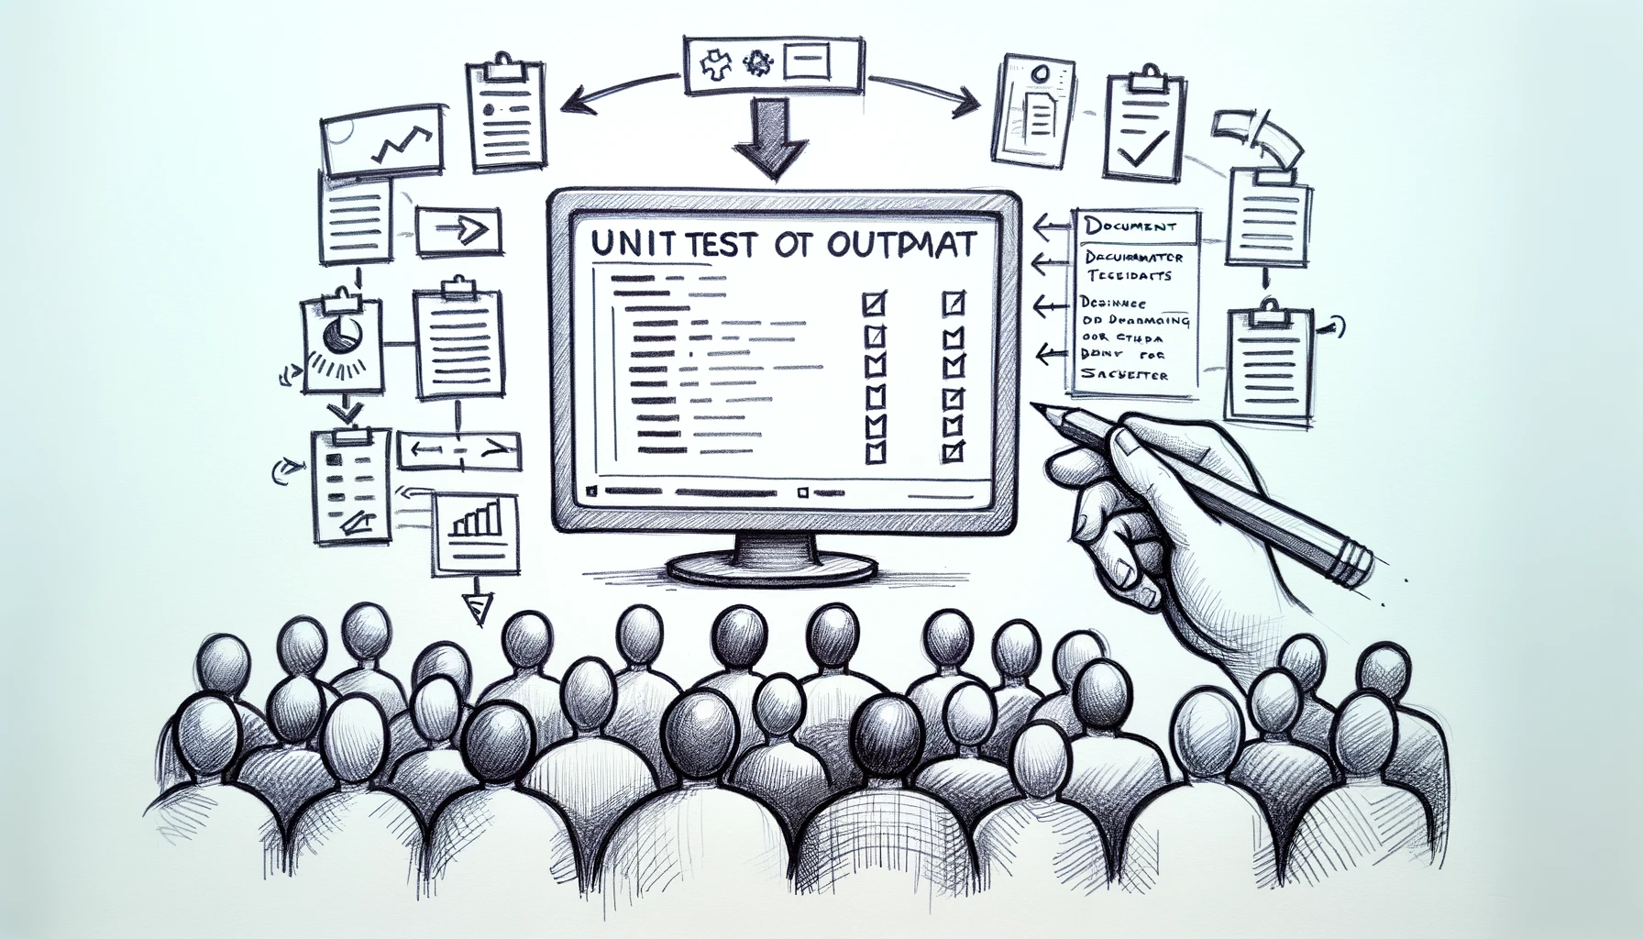
Better Testing with Approvals
Telling
Better Stories
with Tests
Llewellyn Falco
Lada Kesseler
Llewellyn Falco
Lada Kesseler

Slide 2
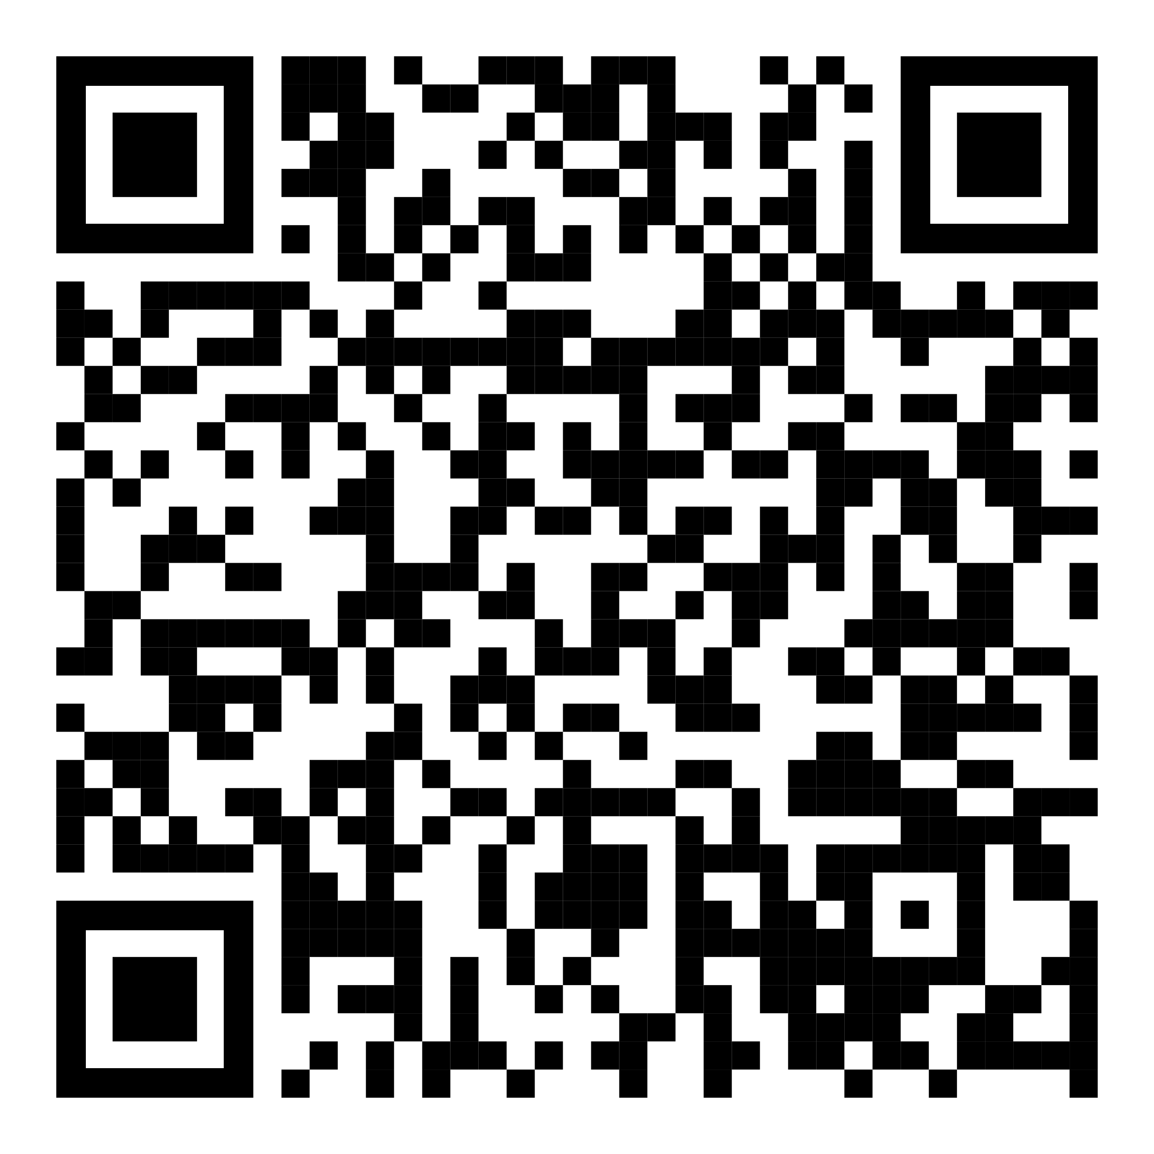
Resources
github.com/isidore/Talks/blob/master/BetterTestingWithApprovals.md
Notes:
https://github.com/isidore/Talks/blob/master/BetterTestingWithApprovals.md

Slide 3
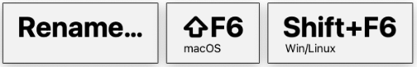
Housekeeping:
Presentation assistant

Slide 4
Housekeeping:
Presentation assistant

Slide 5

..
..
Clear
Expressive
Simple
Notes:
Re-telling
just under test
iterative experience
stakeholder documentation
Lada set the stage
couple months
working together
chatbot application
converted manual tests
fast tests
hexagonal architecture
without DynamoDb or Kafka
excited
show
Good unit tests, but failed attempt at anything above – because integration tests are fraglie
Tried something new, refactored the system to hexagonal
Automated tests that weren’t depending on infrastructure

Slide 6

In the beginning...

Slide 7
code

Slide 8
Problem:
What the test does is confusing

Slide 9
New Concept #1:
Testing Circle

Slide 10
// Create side (0,0) – (3,4)
// Verify length
Whiteboard
English
Testing Circle
Result
Code
Side (0,0) – (3,4) length = 5
Side s = new Side(0,0,3,4);
Approvals.Verify(s + “ length = “ +s.Length);

Slide 11
// Create side (0,0) – (3,4)
// Verify length
Whiteboard
English
Testing Circle
Result
Code
Side (0,0) – (3,4) length = 5
Side s = new Side(0,0,3,4);
Approvals.Verify(s + “ length = “ +s.Length);

Slide 12
// Create side (0,0) – (3,4)
// Verify length
Whiteboard
English
Testing Circle
Result
Code
Side (0,0) – (3,4) length = 5
Side s = new Side(0,0,3,4);
Approvals.Verify(s + “ length = “ +s.Length);

Slide 13
// Create side (0,0) – (3,4)
// Verify length
Whiteboard
English
Testing Circle
Result
Code
Side (0,0) – (3,4) length = 5
Side s = new Side(0,0,3,4);
Approvals.Verify(s + “ length = “ +s.Length);

Slide 14
// Create side (0,0) – (3,4)
// Verify length
Whiteboard
English
Testing Circle
Result
Code
Side (0,0) – (3,4) length = 5
Side s = new Side(0,0,3,4);
Approvals.Verify(s + “ length = “ +s.Length);

Slide 15
Chat
[Customer]
hi
[Bot]
Hi there! I'm your virtual assistant.
What would you like to do today?
Notes:
we put the focus on what it is that we're testing, and not the setup of the test

Slide 16
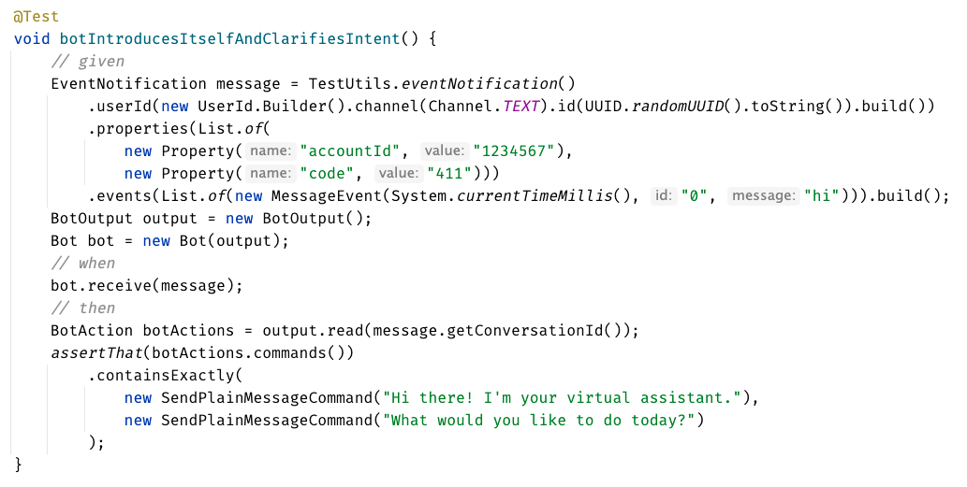

Slide 17
Chat
[Customer]
hi
[Bot]
Hi there! I'm your virtual assistant.
What would you like to do today?
Whiteboard
English
Testing Circle
Result
Code

Slide 18
Chat
[Customer]
hi
[Bot]
Hi there! I'm your virtual assistant.
What would you like to do today?
// customer says ‘hi’
// verify conversation
Whiteboard
English
Testing Circle
Result
Code

Slide 19
Chat
[Customer]
hi
[Bot]
Hi there! I'm your virtual assistant.
What would you like to do today?
// customer says ‘hi’
// verify conversation
Whiteboard
English
Testing Circle
Result
Code
String userMessage = "hi"; verifyConversation(userMessage);

Slide 20
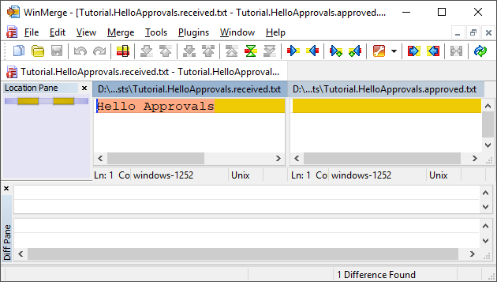
New Concept #2:
Approval Tests
Test + approved output

Slide 21
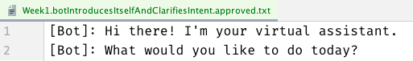
Chat
[Customer]
hi
[Bot]
Hi there! I'm your virtual assistant.
What would you like to do today?
// customer says ‘hi’
// verify conversation
Whiteboard
English
Testing Circle
Result
Code
String userMessage = "hi"; verifyConversation(userMessage);

Slide 22
Chat
[Customer]
hi
[Bot]
Hi there! I'm your virtual assistant.
What would you like to do today?
// customer says ‘hi’
// verify conversation
Whiteboard
English
Testing Circle
Result
Code
[Customer]: hi
String userMessage = "hi"; verifyConversation(userMessage);

Slide 23
Week 1
What happened
Notes:
Pay attention to the testing circle
Create convenience functions to hide unnecessary details

Slide 24
Complex
Tests
ApprovalTests
Testing Circle

Slide 26
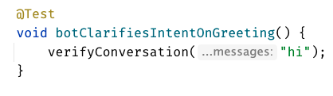
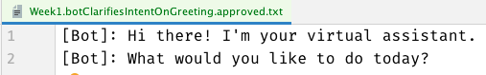

Slide 28
Week 1
learnings
Convenience Functions
ApprovalTests
Testing Circle
verifyConversation("hi");
Notes:
Pay attention to the testing circle
Create convenience functions to hide unnecessary details

Slide 29
...later next week...

Slide 30
code

Slide 31
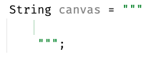
New Concept #3:
Story Board

Slide 32
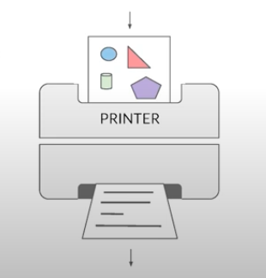
New Concept #4:
Printers
@EmillyBache

Slide 33
Problem:
Lack of clarity in the test code output

Slide 34
Chat
[Customer]
hi
[Bot]
Hi there! I'm your virtual assistant.
What would you like to do today?
[Customer]
pay bill
[Bot]
Are you a customer?
Yes, I'm a customer No, I'm not

Slide 35
[Customer]: hi [ Bot]: Hi there! I'm your virtual assistant. [ Bot]: What would you like to do today? [Customer]: pay bill [ Bot]: Let me try to help you. [ Bot]: { "content": { "type": "vertical", "elements": [ { "type": "text", "text": "Are you a customer?", "tooltip": "text tooltip" }, { "type": "horizontal", "elements": [ { "type": "button", "title": "Yes", "click": { "actions": [ { "type": "publishText", "text": "Yes, I'm a customer" } ] } }, { "type": "button", "title": "No", "click": { "actions": [ { "type": "publishText", "text": "No, I'm not" } ] } } ] } ] } }
Chat
[Customer]
hi
[Bot]
Hi there! I'm your virtual assistant.
What would you like to do today?
[Customer]
pay bill
[Bot]
Are you a customer?
Yes, I'm a customer No, I'm not

Slide 36
Week 2
What happened
Notes:
Pay attention to the testing circle
Create convenience functions to hide unnecessary details

Slide 37

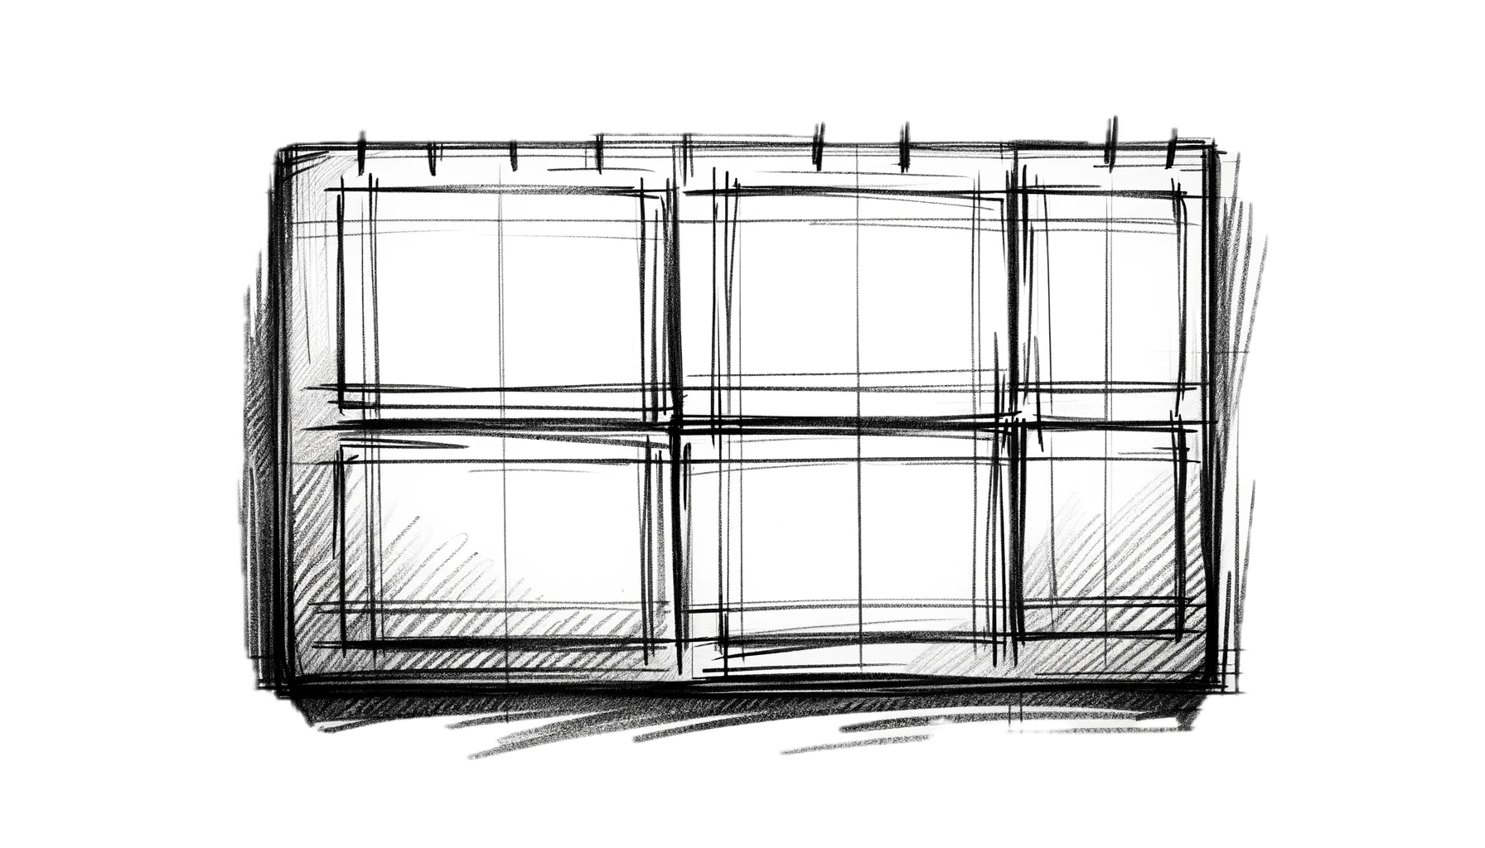
Complex
Tests
ApprovalTests
Testing Circle
Printers
+ Storyboard
JSON

Slide 38
Formatting
[Customer]: hi [Bot]: Hi there! I'm your virtual assistant. [Bot]: What would you like to do today?
[Customer]: hi [ Bot]: Hi there! I'm your virtual assistant. [ Bot]: What would you like to do today?

Slide 39
Formatting
[Customer]: hi [Bot]: Hi there! I'm your virtual assistant. [Bot]: What would you like to do today? [Customer]: hi [Bot]: Hmmm, tell me a little more so I can help you. What would you like to do today? [Customer]: hi [Bot]: Let me try to help you. [Bot]: Are you a customer? 1) Yes, I'm a customer 2) No, I'm not
[Customer]: hi
[ Bot]: Hi there! I'm your virtual assistant. [ Bot]: What would you like to do today? [Customer]: hi [ Bot]: Hmmm, tell me a little more so I can help you. [ ]: What would you like to do today? [Customer]: hi [ Bot]: Let me try to help you. [ Bot]: Are you a customer? [ ]: 1) Yes, I'm a customer [ ]: 2) No, I'm not

Slide 40
[Customer]: hi [ Bot]: Hi there! I'm your virtual assistant. [ Bot]: What would you like to do today? [Customer]: pay bill [ Bot]: Let me try to help you. [ Bot]: { "content": { "type": "vertical", "elements": [ { "type": "text", "text": "Are you a customer?", "tooltip": "text tooltip" }, { "type": "horizontal", "elements": [ { "type": "button", "title": "Yes", "click": { "actions": [ { "type": "publishText", "text": "Yes, I'm a customer" } ] } }, { "type": "button", "title": "No", "click": { "actions": [ { "type": "publishText", "text": "No, I'm not" } ] } } ] } ] } }
[Customer]: hi [ Bot]: Hi there! I'm your virtual assistant. [ Bot]: What would you like to do today? [Customer]: pay bill [ Bot]: Let me try to help you. [ Bot]: Are you a customer? [ ]: 1) Yes, I'm a customer [ ]: 2) No, I'm not

Slide 41
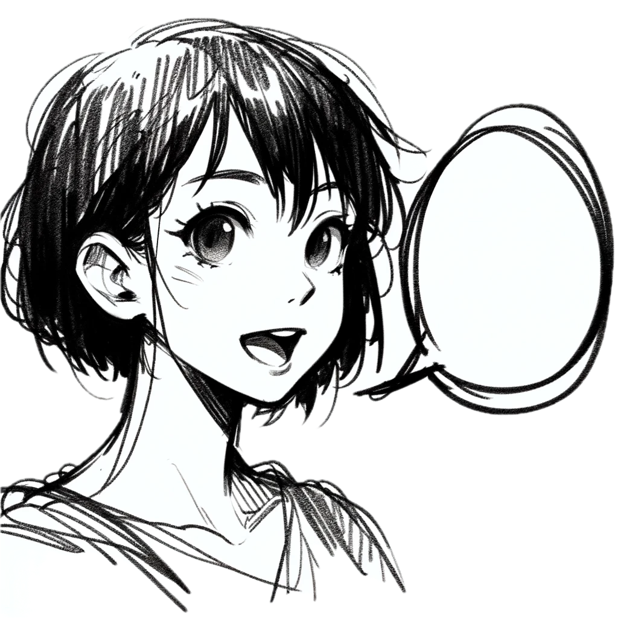
Week 2
learnings
Storytelling
Storyboard
Printers
Formatting
[Customer]: talk to an operator [ Bot]: Hi there! I'm your virtual assistant. [ Bot]: Let me try to help you. [ Bot]: Are you a customer? [ ]: 1) Yes, I'm a customer [ ]: 2) No, I'm not
Notes:
Pay attention to the testing circle
Create convenience functions to hide unnecessary details

Slide 42
...later next week...

Slide 43
code

Slide 44
Problem:
Too many .approved. files

Slide 45
New Concept #5:
Inline Approvals

Slide 46
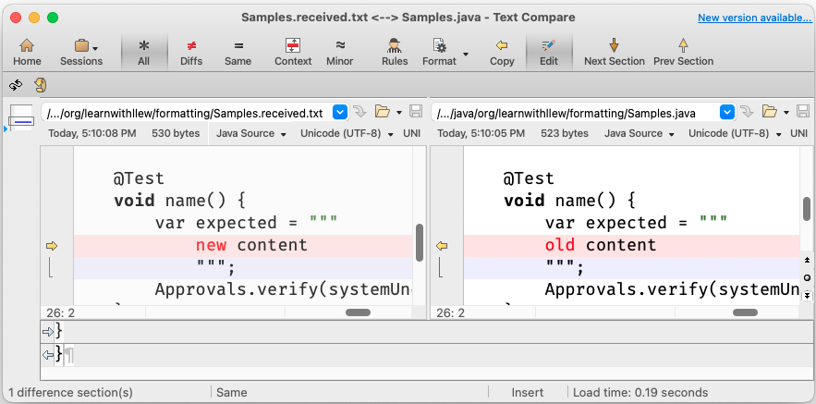
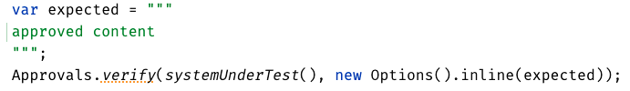
New Concept:
Inline Approvals
“Look mom, no files!”
Possible new source file
Original source file
Approved output
How to invoke
Pressing this modifies
your source code

Slide 47
Week 3
What happened
Notes:
Pay attention to the testing circle
Create convenience functions to hide unnecessary details

Slide 48
Complex
Tests
ApprovalTests
Testing Circle
Printers
+ Storyboard
JSON
Inline

Slide 49
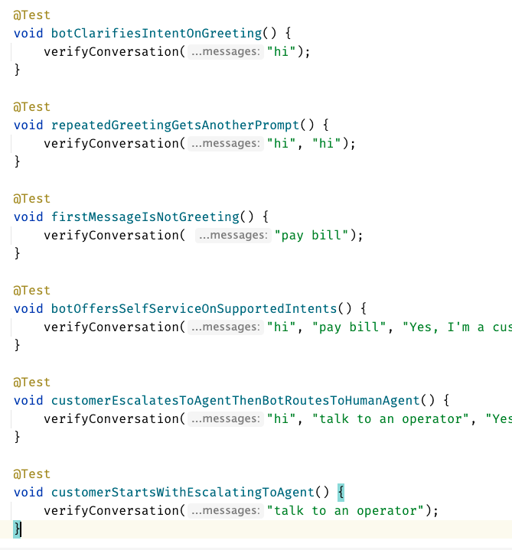
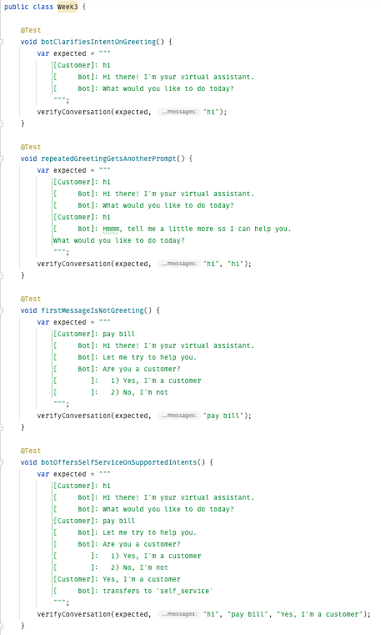
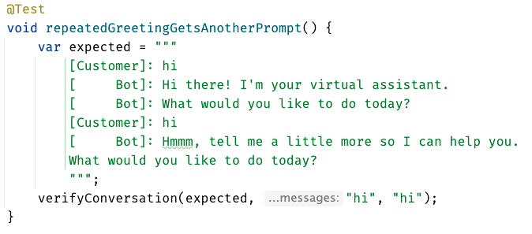
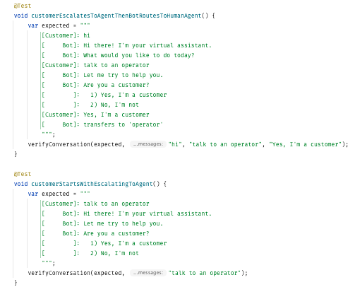
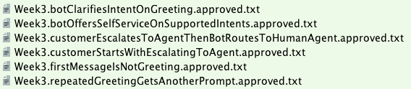

Slide 50
Week 3
learnings
Inline
Notes:
Pay attention to the testing circle
Create convenience functions to hide unnecessary details

Slide 51
...later next week...

Slide 52
code
Notes:
Hey Llewellyn, look what I did

Slide 53
Problem:
Can’t see the overall test strategy
hard to see if you’re missing cases...

Slide 54
New Concept #6:
verifyAll()

Slide 55
New Concept #7:
many of one

Slide 56
Week 4
What happened
Notes:
Pay attention to the testing circle
Create convenience functions to hide unnecessary details

Slide 57
Complex
Tests
ApprovalTests
Testing Circle
Printers
+ Storyboard
JSON
Verify all
Inline

Slide 58
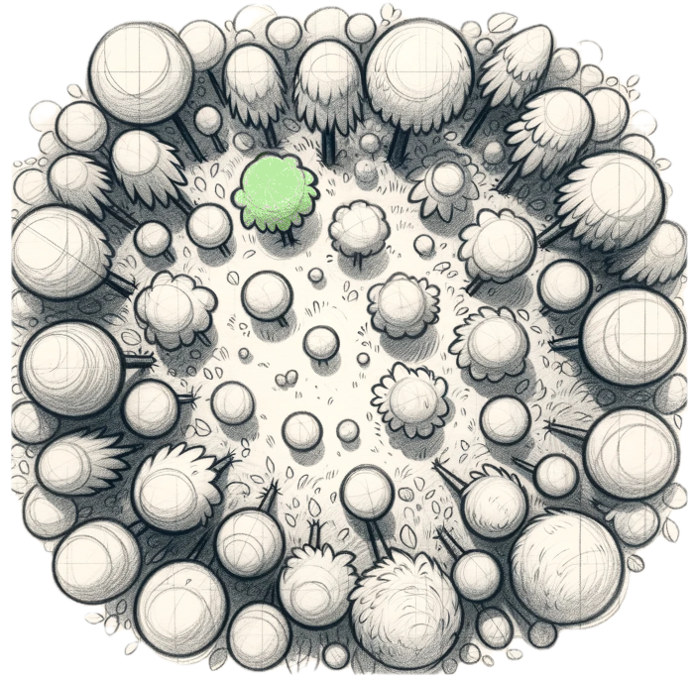
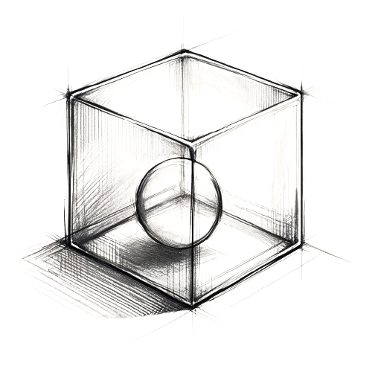
Week 4
learnings
Verify all
Many of One
Printers
See the forest AND the trees
Notes:
Pay attention to the testing circle
Create convenience functions to hide unnecessary details

Slide 59
...later next week...

Slide 60
code
Notes:
1. convert to MultipleConversations (many of one)
2. add DSL (thenConversations)
3. move test1
4. move test2

Slide 61
Problem:
95% of tests are together
but 5% are alone...

Slide 62
New Concept #8:
Custom test scenario builders
creating Domain-Specific Language (DSLs)

Slide 63
Week 5
What happened
Notes:
Pay attention to the testing circle
Create convenience functions to hide unnecessary details

Slide 64
Complex
Tests
ApprovalTests
Testing Circle
Printers
+ Storyboard
JSON
Verify all
Inline
Test Scenario DSL

Slide 65
var conv1 = conversation("pay bill", "Yes, I'm a customer"); var conv2 = conversation("pay bill"); var conversations = List.of(conv1, conv2);
conversation("pay bill", "No, I'm not") .thenConversation("pay bill")

Slide 66
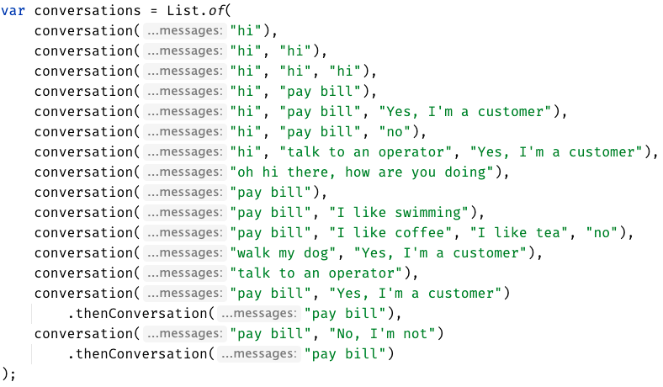

Slide 67

Week 5
learnings
See the forest AND the trees
(consistency)
Test Scenario DSL
Notes:
Invest in APIs that make it easier to express test scenarios

Slide 68
...later next week...

Slide 69
code
Notes:
Hey Llewellyn, look what I did

Slide 70
Problem:
The tests are only for developers

Slide 71
New Concept #9:
Alternative .approved. files
new Options().forFile().withExtension(".md")
Notes:
stakeholders

Slide 72
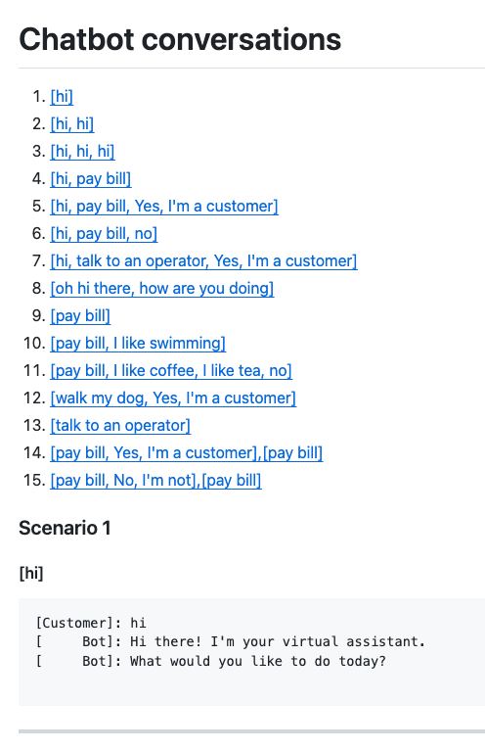
Complex
Tests
ApprovalTests
Testing Circle
Printers
+ Storyboard
markdown
Tests
work as Documentation
JSON
Verify all
Inline
Test Scenario DSL

Slide 73
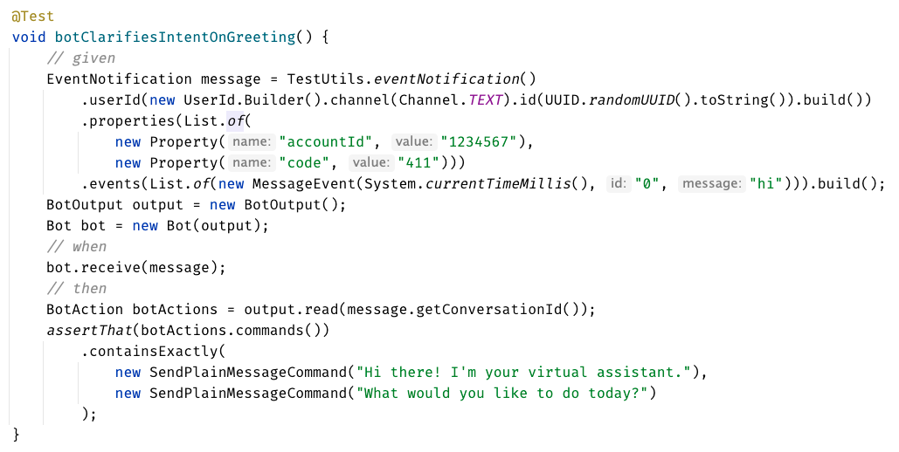
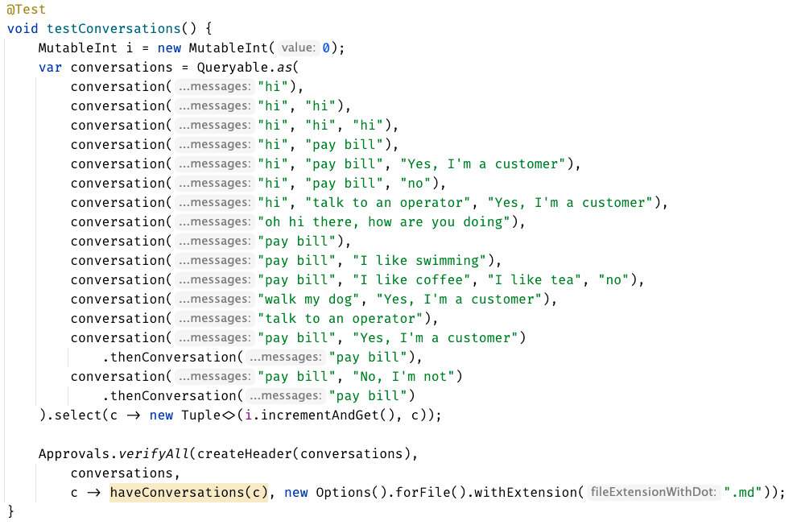

Slide 74
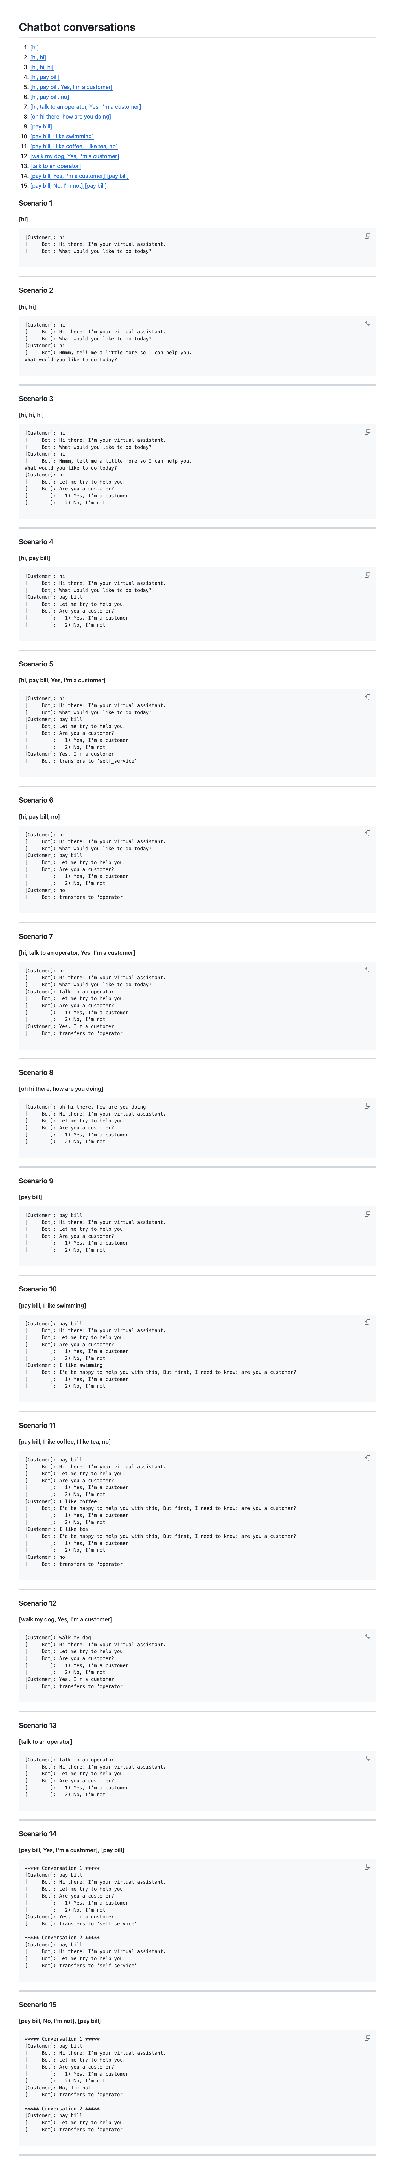

Slide 77
Concepts:
1. Testing Circle
2. Approval Tests
3. Story Board
4. Printers
5. Inline Approvals
6. verifyAll()
7. Many of one
8. Custom test scenario builders (DSL)
9. Alternative .approved. files (markdown)

Slide 78
learnings
Storyboard
ApprovalTests
Storytelling
Testing Circle
Printers
Inline
Convenience Functions
verifyConversation("hi");
Test Scenario DSL
See the forest AND the trees
Verify all
Markdown
Notes:
Pay attention to the testing circle
Create convenience functions to hide unnecessary details

Slide 79
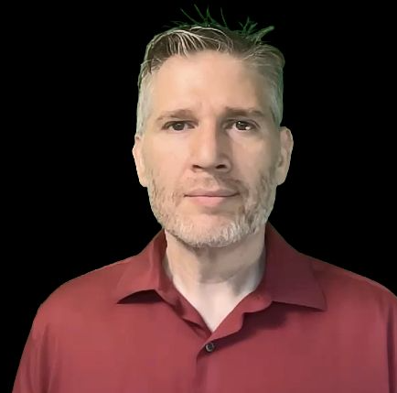

Resources
Thank you!
Llewellyn Falco
Lada Kesseler
Please connect on LinkedIn
Notes:
https://github.com/isidore/Talks/blob/master/BetterTestingWithApprovals.md

Slide 80
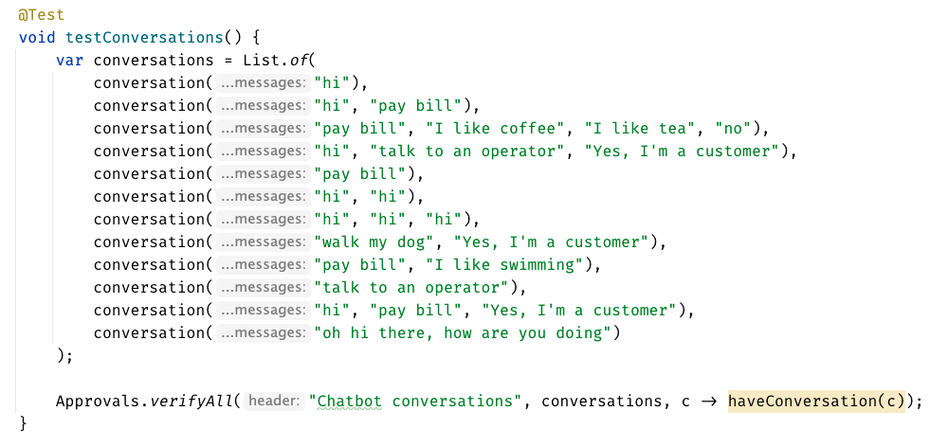

Slide 81
Chat
[Customer]
hi
[Bot]
Hi there! I'm your virtual assistant.
What would you like to do today?
Whiteboard
English
Testing Circle
Result
Code

Slide 82
Test.approved.txt
[Bot]: Hi there! I'm your virtual assistant. [Bot]: What would you like to do today?
Test.approved.txt
[Customer]: hi
[ Bot]: Hi there! I'm your virtual assistant. [ Bot]: What would you like to do today?

Slide 83
var expected = """ [Customer]: hi [ Bot]: Hi there! I'm your virtual assistant. [ Bot]: What would you like to do today? """; verifyConversations(expected, "hi");

Slide 84
var conversations = List.of( conversation("hi"), conversation("hi", "hi"), conversation("hi", "hi", "hi"), conversation("hi", "pay bill"), conversation("hi", "pay bill", "Yes, I'm a customer"), conversation("hi", "pay bill", "no"), conversation("hi", "talk to an operator", "Yes, I'm a customer"), conversation("oh hi there, how are you doing"), conversation("pay bill"), conversation("pay bill", "I like swimming"), conversation("pay bill", "I like coffee", "I like tea", "no"), conversation("walk my dog", "Yes, I'm a customer"), conversation("talk to an operator") );
conversation("pay bill", "No, I'm not") .thenConversation("pay bill")

